Slide 1


Introduction to Azure, IoT and Azure IoT Hub
Kishore Chowdary
@codesizzler | @kishore_1702
C-Sharp Corner MVP
www.kishorechowdary.com

Slide 2

Azure
Azure is Microsoft’s cloud computing platform, a growing collection of integrated services—analytics, computing, database, mobile, networking, storage, and web—for moving faster, achieving more, and saving money.

Slide 3



Azure Service Models
IaaS
PaaS
SaaS
Infrastructure-as-a-Service
Platform-as-a-Service
Software-as-a-Service
host
build
consume

Slide 4
On Premises
Infrastructure
(as a Service)
Platform
(as a Service)
Software
(as a Service)
You manage
Applications
Applications
Applications
Applications
Data
You manage
Data
Data
Data
Runtime
Runtime
Runtime
Runtime
Managed by Microsoft
You manage
Middleware
Middleware
Middleware
Managed by Microsoft
Middleware
O/S
O/S
O/S
O/S
Managed by Microsoft
Virtualization
Virtualization
Virtualization
Virtualization
Servers
Servers
Servers
Servers
Storage
Storage
Storage
Storage
Networking
Networking
Networking
Networking

Slide 5
Azure Services
Web Apps
Virtual Machines
Storage
Databases
Networking
Internet Of Thongs
AI + Cognitive Services
More..

Slide 6
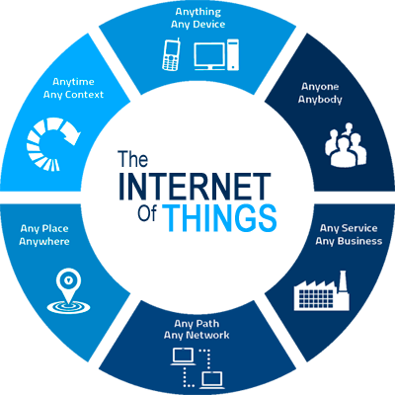
IoT

Slide 7
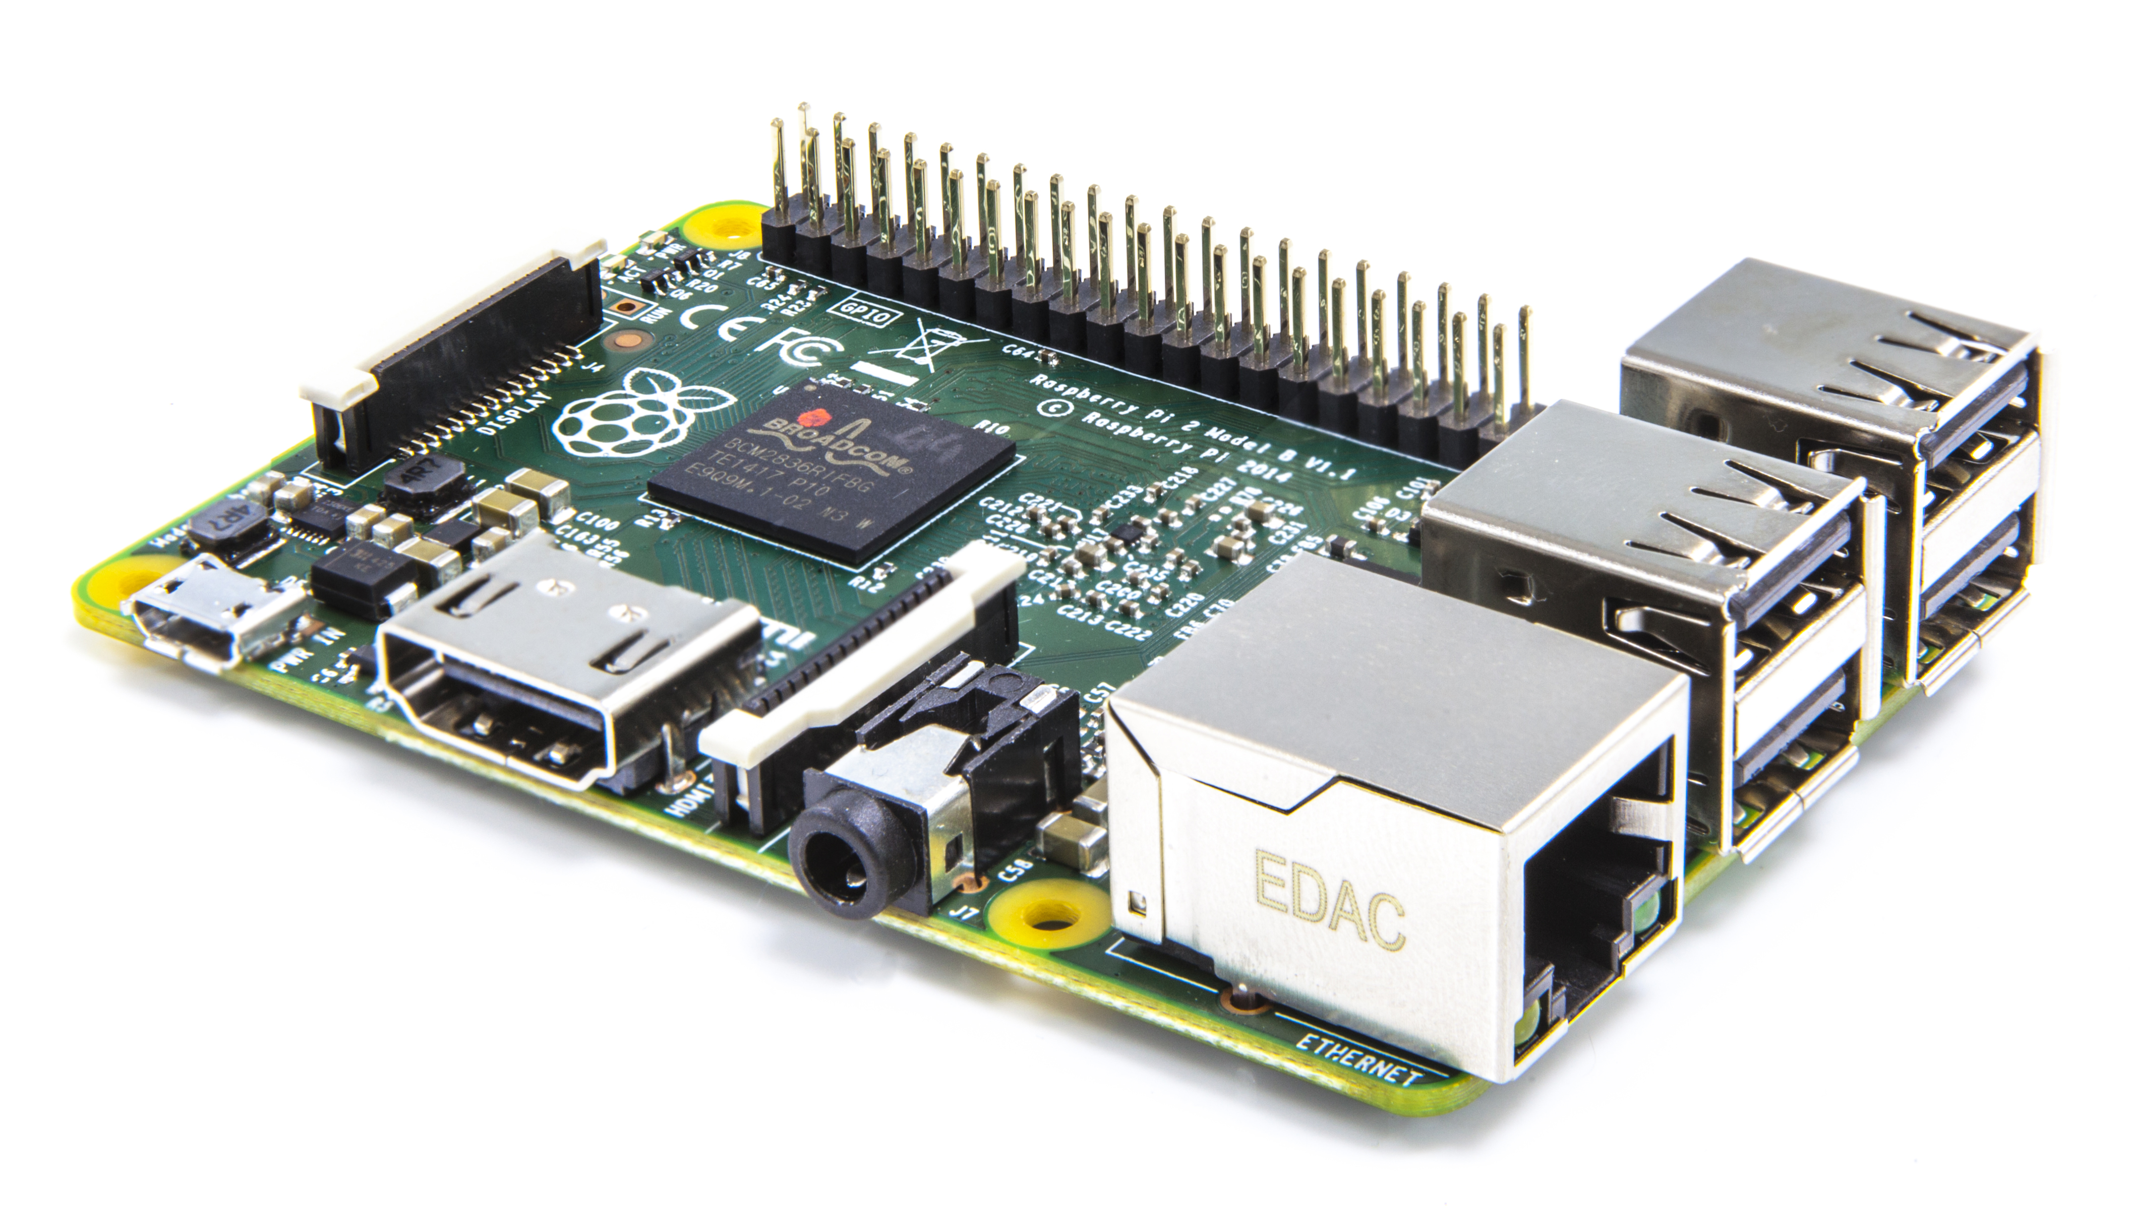
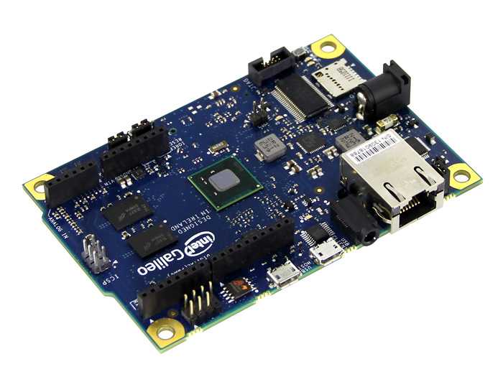
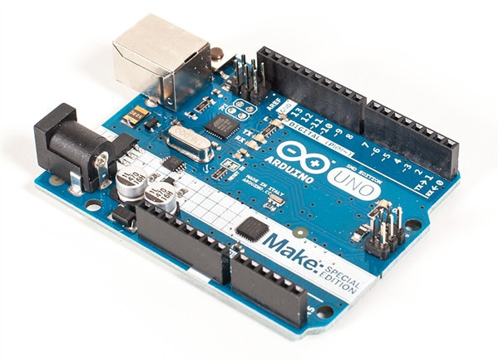
IOT Devices
Raspberry Pi
Galileo
Arduino

Slide 8
IOT OS
Microcontroller | Microprocessor
Windows 10 IoT core
RIOT OS
Android Things
Raspbian OS

Slide 9
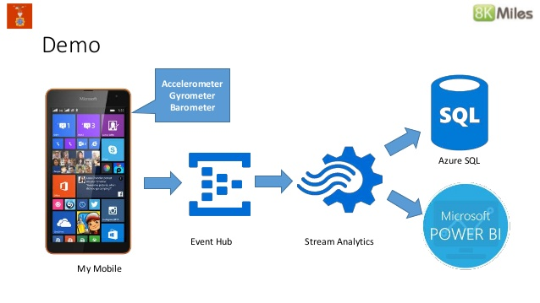
Azure IoT Event Hub

Slide 10
Thank You
Kishore Chowdary
@codesizzler | @kishore_1702
C-Sharp Corner MVP
www.kishorechowdary.com

